Slide 1
Analyzing Stock Data with Python
Sohrab N Godrej

Slide 2
Intro: The Project
Data Import
Analyzing Stock Data
Creating Random Porfolios
Plotting Portfolios
Optimizing Portfolios
Adding More Stocks to the Portfolio
Conclusion

Slide 3
The Project
Using Python, I’ve created a program that is able to read stock data and analyze stock performance over time.
The program is able to make suggestions to users about how to allocate financial resources as efficiently as possible, based on past performance of stocks.
Users will have the ability to look at different possible portfolios containing stocks that they are interested in. Different portfolios will have different distributions (weights) of the chosen stocks and different expected returns and risks (volatility)

Slide 4
Intro: The Project
Data Import
Analyzing Stock Data
Creating Random Porfolios
Plotting Portfolios
Optimizing Portfolios
Adding More Stocks to the Portfolio
Conclusion

Slide 5
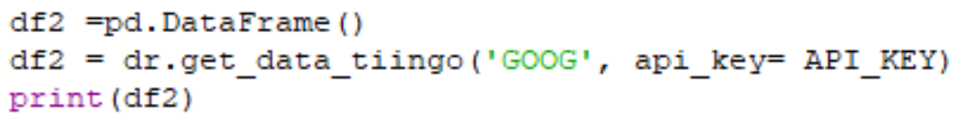
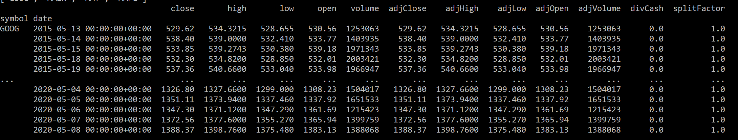
Data Import
All stock data is retrieved from Tiingo, an Application Program Interface (API) that contains stock price information.
The specific python command used was getdatatiingo(), for example
This produces the following output of stock data for the stock “GOOG” (Alphabet Inc. Class C)

Slide 6
Intro: The Project
Data Import
Analyzing Stock Data
Creating Random Porfolios
Plotting Portfolios
Optimizing Portfolios
Adding More Stocks to the Portfolio
Conclusion

Slide 7
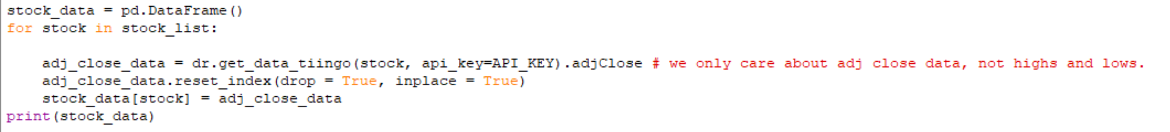
Analyzing Stock data
Since we are looking at the long term performance of stocks, we only need information in the adjClose column. Daily highs and lows do not affect our analysis of how the stock is doing over long periods of time (~5 years or more)
The adjClose column can be retrieved using the similar command with .adjClose appended to the end:
Here, stock is a string variable containing the NASDAQ symbol for the stock. Example: ‘GOOG’ for Alphabet Inc. Class C.
stock_list is a string list containing the stock symbols that the user is interested in.

Slide 8
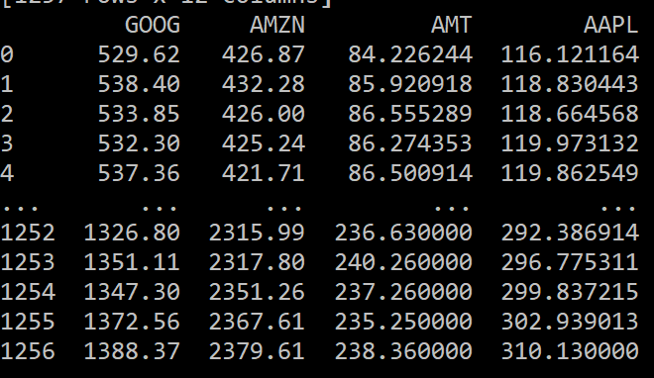
Analyzing Stock Data
This code results in the following data frame (named stock_data) being created:
This data frame contains adjusted closing prices of the four stocks that made up the string list ‘stock_list’.
GOOG: Alphabet Inc. Class C
AMZN: Amazon.com, Inc.
AMT: American Tower Corp
AAPL: Apple Inc.

Slide 9
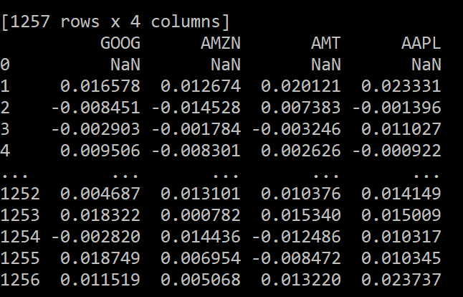
Calculating Daily Returns
Now that we have data for the adjusted closing price of each stock, we would like to know the daily returns of each stock. This is done using the pandas function pct_change() [% change], for example:
This results in the following output:

Slide 10
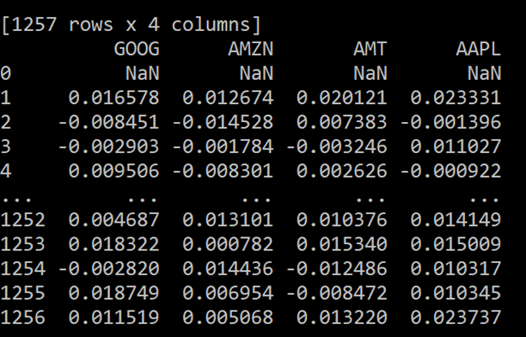
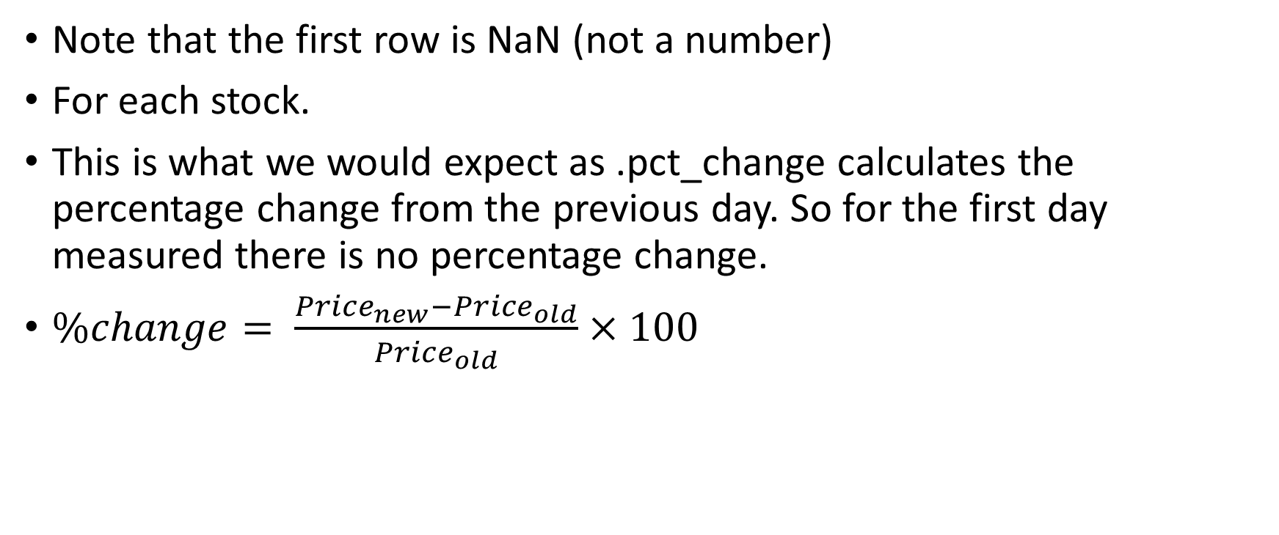
Calculating Daily Returns
Note that the first row is NaN (not a number)
For each stock.
This is what we would expect as .pct_change calculates the percentage change from the previous day. So for the first day measured there is no percentage change.

Slide 11
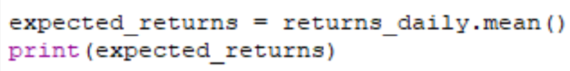
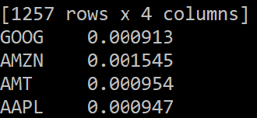
Calculating Expected Returns
Now that we have the daily percentage changes of stock price, we need to calculate the expected returns of each stock.
This is done using the arithmetic mean (pandas function .mean()) as in the example below.
The resulting output is the following data frame:
This data frame contains the average returns for each stock over the five year period.
The expected returns will give us a prediction for future returns (although past performance does not guarantee future success or failure)

Slide 12
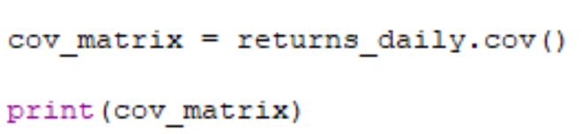
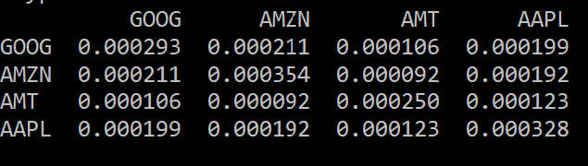
Calculating Volatility (The Covariance Matrix)
The volatility of the portfolio is calculated using covariance matrix (pandas function .cov()) as shown below:
This results in the following output:

Slide 13
Calculating Volatility (The Covariance Matrix)
This data frame is called the covariance matrix
The diagonal of the covariance matrix is the variance of each individual stock. The first diagonal element (0.000293)is the variance of GOOG, the second diagonal element (0.000354) is the variance of AMZN and so on.
Non diagonal elements correspond to the covariance of each stock with other stocks. For example, the first column and second row element (0.000211) is the covariance of GOOG with respect to AMZN and the second column and first row element is the covariance of AMZN with respect to GOOG (The exact same number!)
This will help give us an estimate of the volatility of the portfolio by detrmining how correlated stocks in the portfolio are. (It is worth noting that AMT [American Tower Company] is clearly less correlated than the three tech companies according to the covariance matrix, this will provide stability and security to the portfolio.)

Slide 14
Intro: The Project
Data Import
Analyzing Stock Data
Creating Random Porfolios
Plotting Portfolios
Optimizing Portfolios
Adding More Stocks to the Portfolio
Conclusion

Slide 15
Creating Random Portfolios
We can use the data of expected returns and covariance to generate a number of different portfolios with random distributions (weights) of the assets that the user is interested in.
We can feed the expected returns and covariance matrix into the function return_portfolios() which returns several portfolios of random asset weights with volatility and return values already calculated.

Slide 16
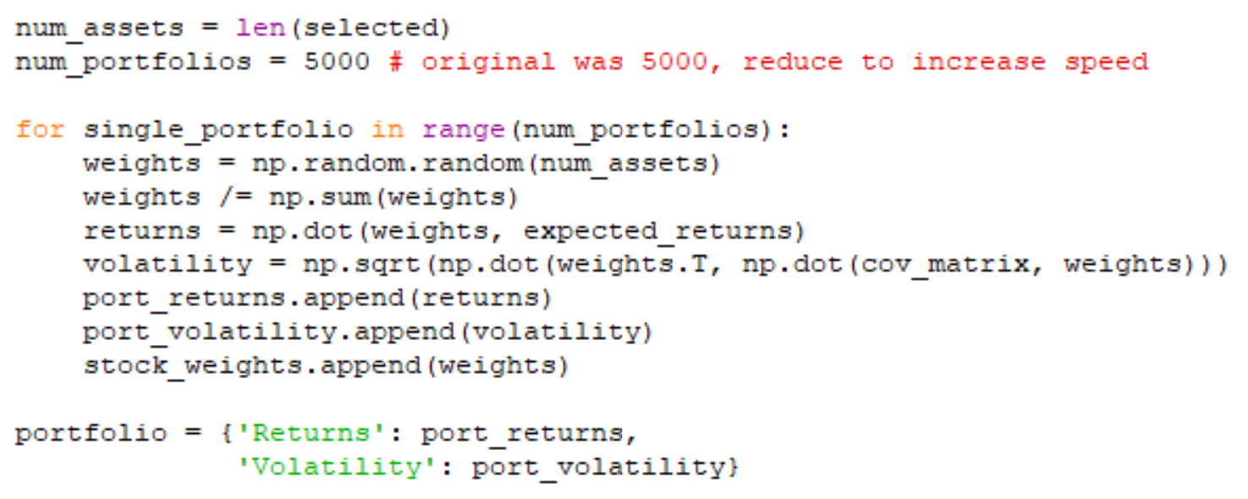
Generating random weights
The return_portfolios() function has a variable called num_portfolios that determines the number of random portfolios that the user would like to look at. It is set to 5000 and can be changed by the user.
Weights are generated at random using the following code

Slide 17
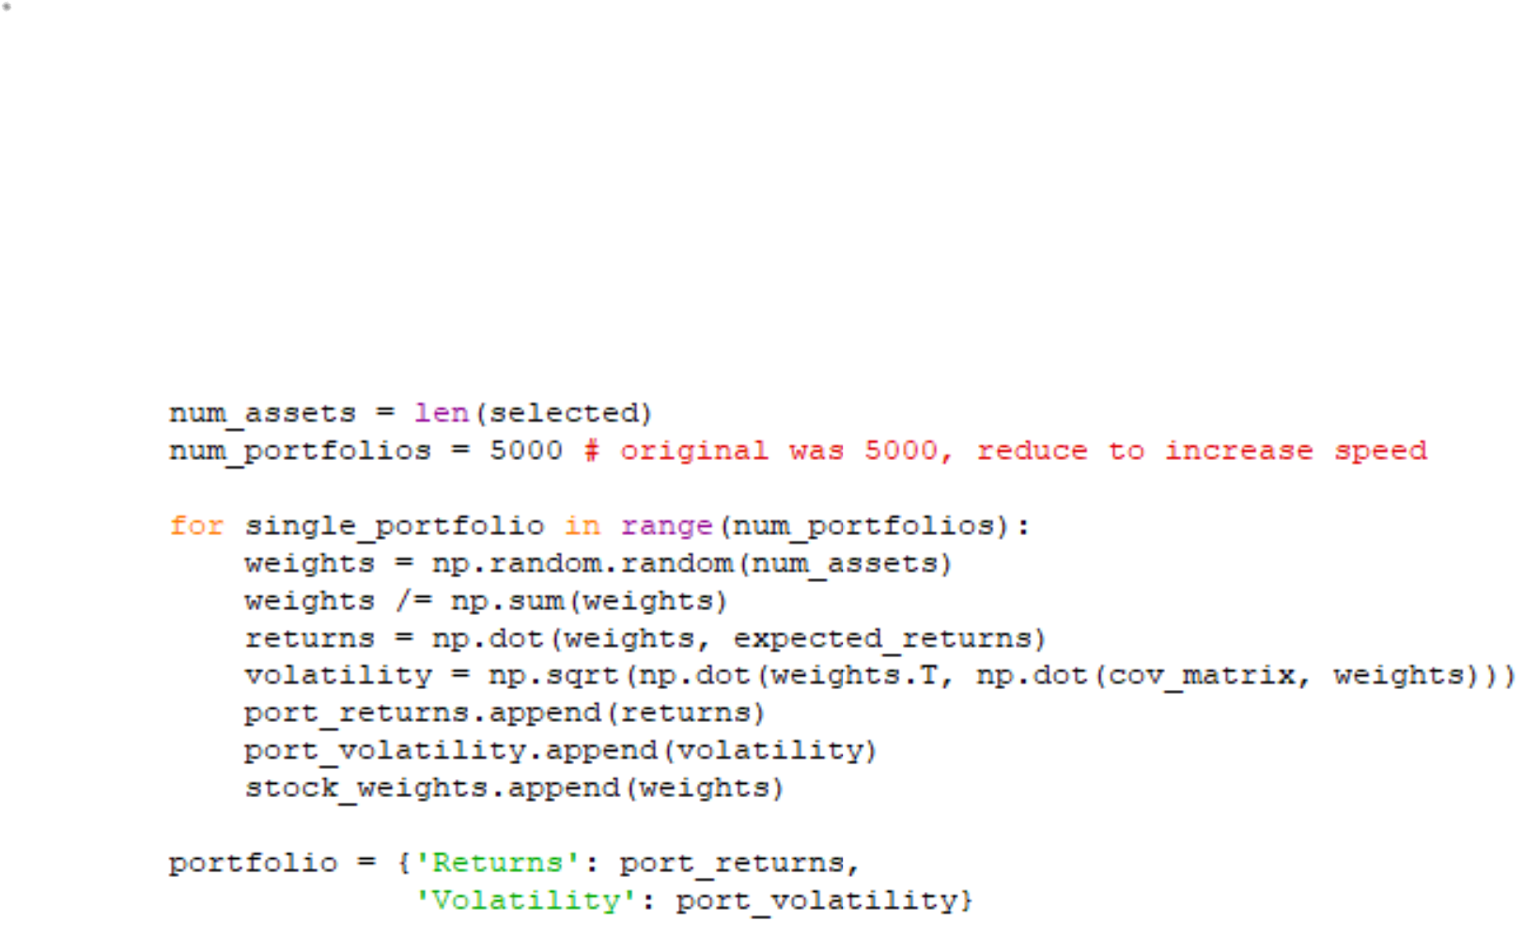
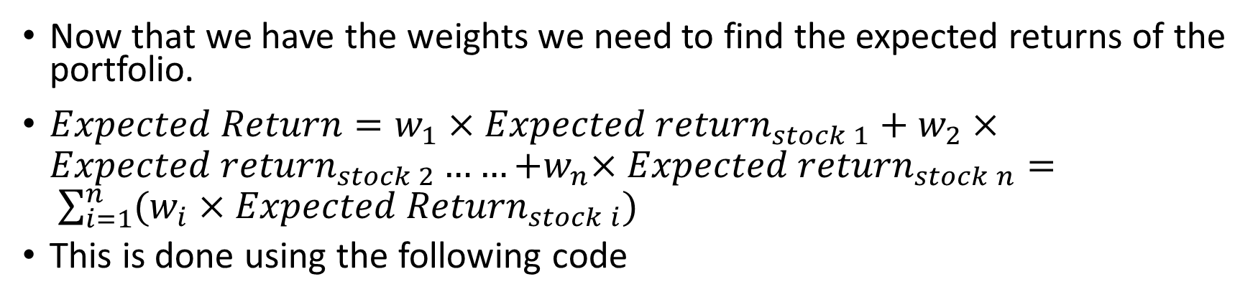
Calculating Expected Returns Based on Weights and Stock Returns
Now that we have the weights we need to find the expected returns of the portfolio.
$Expected Return=w_{1}×{Expected return}_{stock 1}+w_{2}×{Expected return}_{stock 2}……{+w}_{n}×{Expected return}_{stock n}= \sum_{i=1}^{n}{(w_{i}×{Expected Return}_{stock i})}$
This is done using the following code

Slide 18
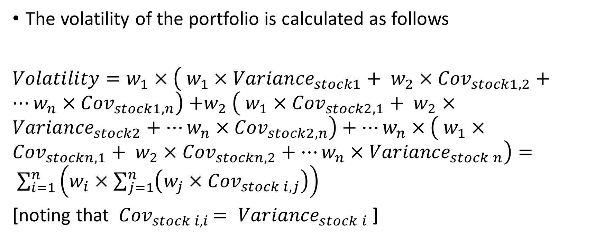
Calculating Volatility Using the Covariance Matrix and Weights
The volatility of the portfolio is calculated as follows
$Volatility=w_{1}×\left( w_{1}×{Variance}_{stock1}+ w_{2}×{Cov}_{stock1,2}+…w_{n}×{Cov}_{stock1,n}\right){+w}_{2}\left( w_{1}×{Cov}_{stock2,1}+ w_{2}×{Variance}_{stock2}+…w_{n}×{Cov}_{stock2,n}\right)+…w_{n}×\left( w_{1}×{Cov}_{stockn,1}+ w_{2}×{Cov}_{stockn,2}+…w_{n}×{Variance}_{stock n}\right)= \sum_{i=1}^{n}{\left(w_{i}×\sum_{j=1}^{n}{\left(w_{j}×{Cov}_{stock i,j}\right)}\right)}$
[noting that ${ Cov}_{stock i,i }= {Variance}_{stock i}$]

Slide 19
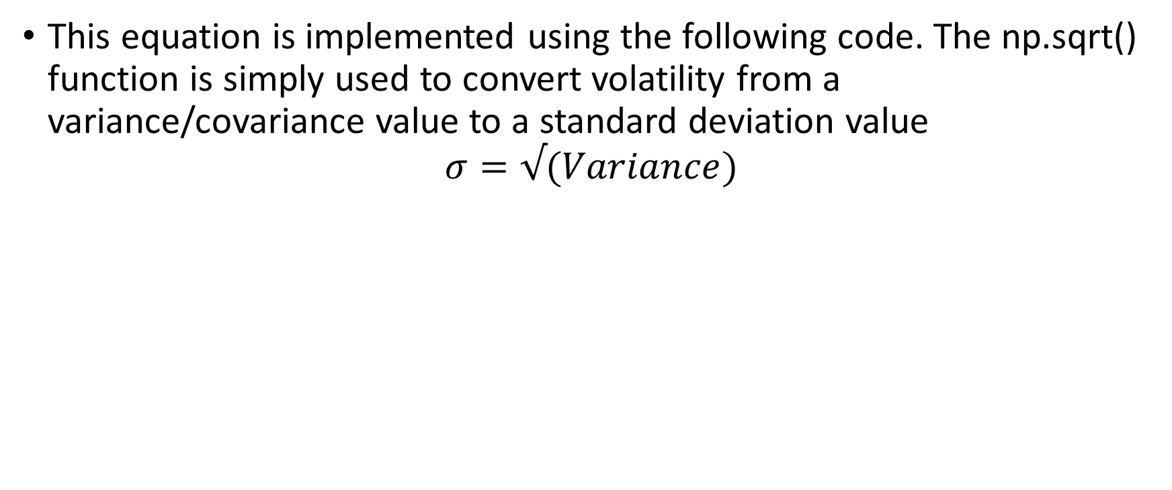
Calculating Volatility Using the Covariance Matrix and Weights
This equation is implemented using the following code. The np.sqrt() function is simply used to convert volatility from a variance/covariance value to a standard deviation value
$$σ=√(Variance)$$

Slide 20
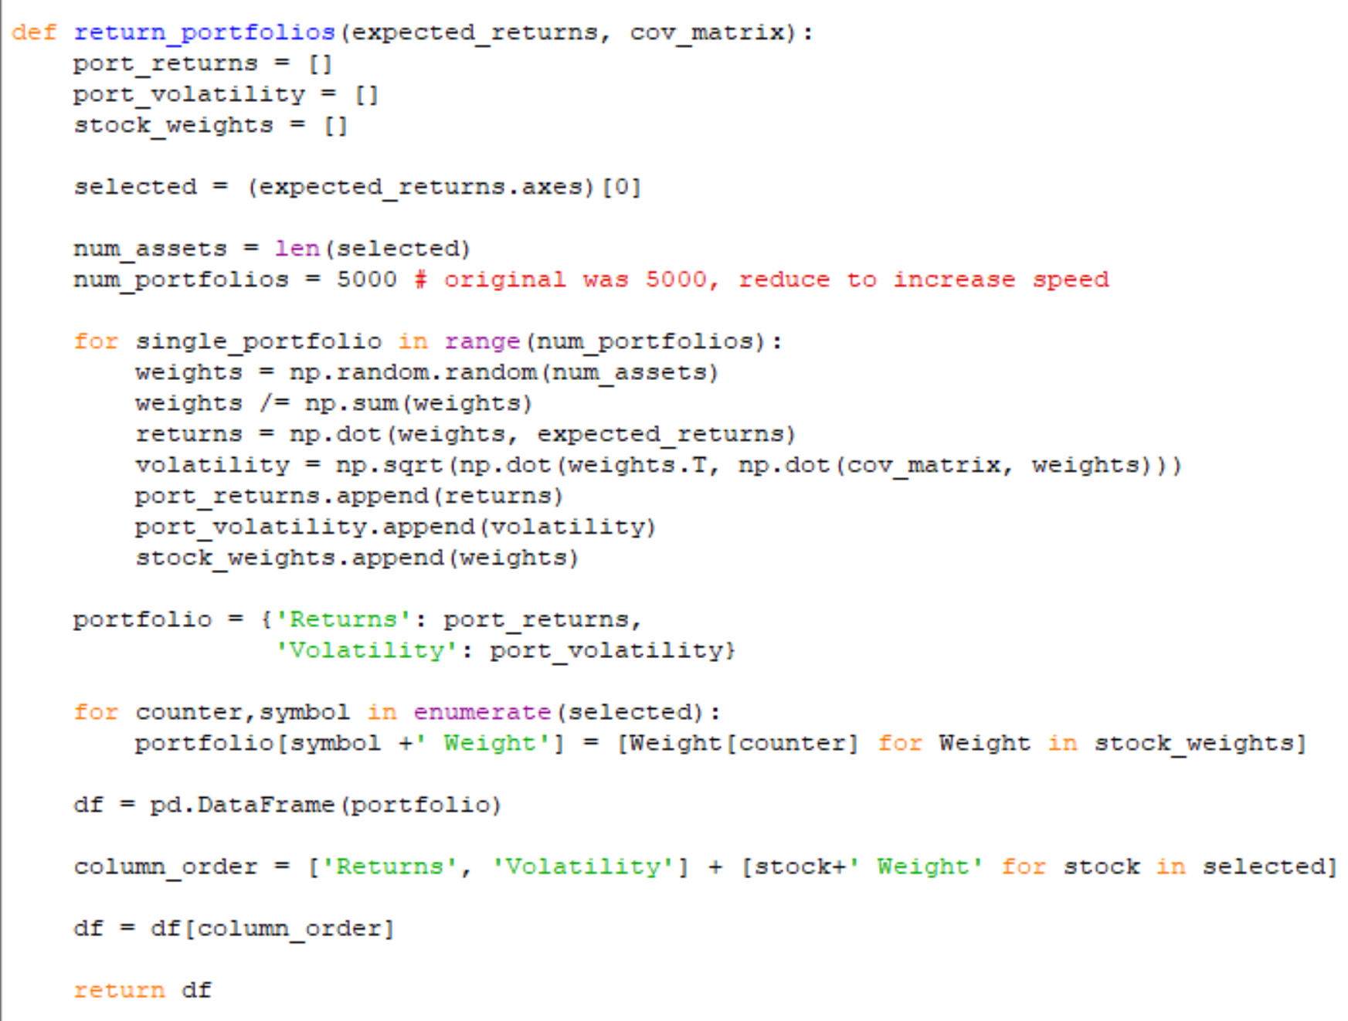
Returning Volatility and Returns
Once Returns and volatility are computed they are stored in a pandas dataframe containing the returns, volatility and asset weights of each individual random portfolio. The data frame is returned at the end of the return_portfolios() function, shown below

Slide 21
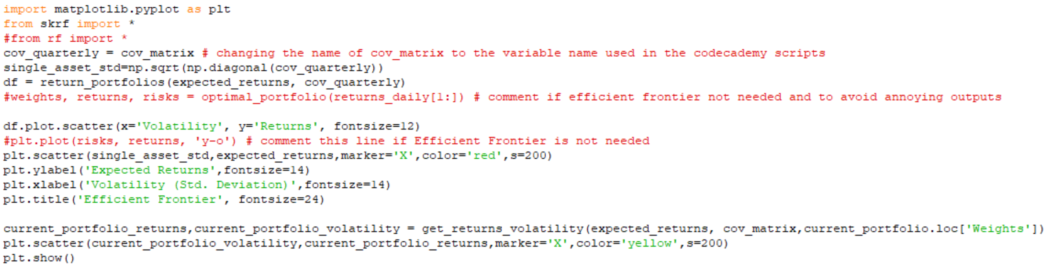
Plotting the Randomized Portfolios
So now that we have a number of randomly generated portfolios for a given set of assets, as well as the returns and risks of each of these portfolios all that is left to do is plot the portfolios with returns versus risks and choose a portfolio that we wish to invest in.

Slide 22
Intro: The Project
Data Import
Analyzing Stock Data
Creating Random Porfolios
Plotting Portfolios
Optimizing Portfolios
Adding More Stocks to the Portfolio
Conclusion

Slide 23
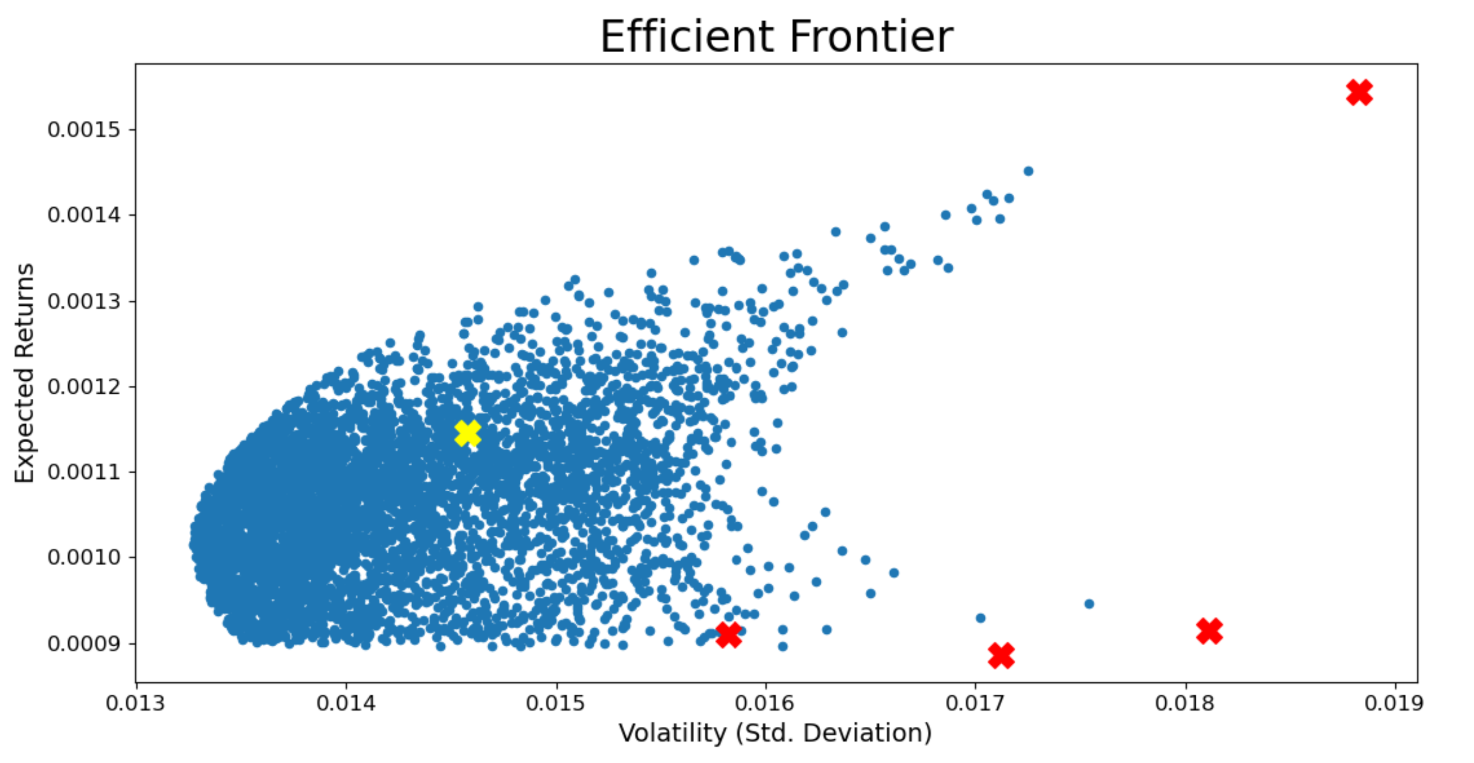
Plotting the Randomized Portfolios
This results in the following plot, showing each randomized portfolio as a blue scatter point. As well as the expected return and volatility of each Individual asset (Red X’s) . The Yellow X represents the distribution of just these four assets taken from a much larger managed portfolio (Citigroup, containing 30 stocks). The weights are shown in the table below. AMT being uncorrelated with the tech stocks greatly reduces the risk of the portfolio
AMZN
 | Weight
GOOG | 21.7%
AMZN | 38%
AMT | 14.5%
AAPL | 25.8%
Managed Portfolio
GOOG
AAPL
AMT

Slide 24
Intro: The Project
Data Import
Analyzing Stock Data
Creating Random Porfolios
Plotting Portfolios
Optimizing Portfolios
Adding More Stocks to the Portfolio
Conclusion

Slide 25
Optimizing the Portfolio for Efficiency
The function optimal portfolio() returns all of the optimal portfolios, i.e portfolios at a certain volatility where expected returns are highest or correspondingly, portfolios of a certain expected return for which volatility is lowest.
These portfolios are said to be on “The Efficient Frontier”

Slide 26
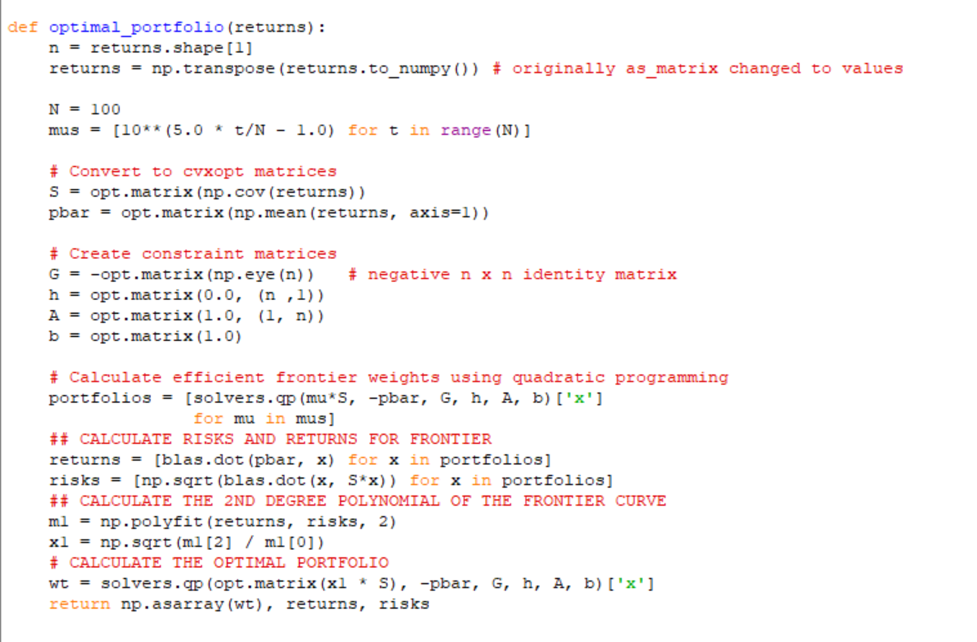
Optimizing the Portfolio for Efficiency
This was done with the following code:

Slide 27
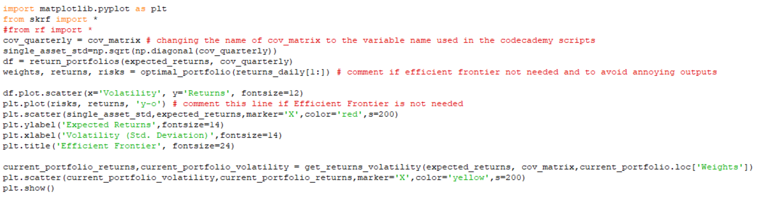
Plotting the Efficient Frontier
The Efficient Frontier was plotted using the following code

Slide 28
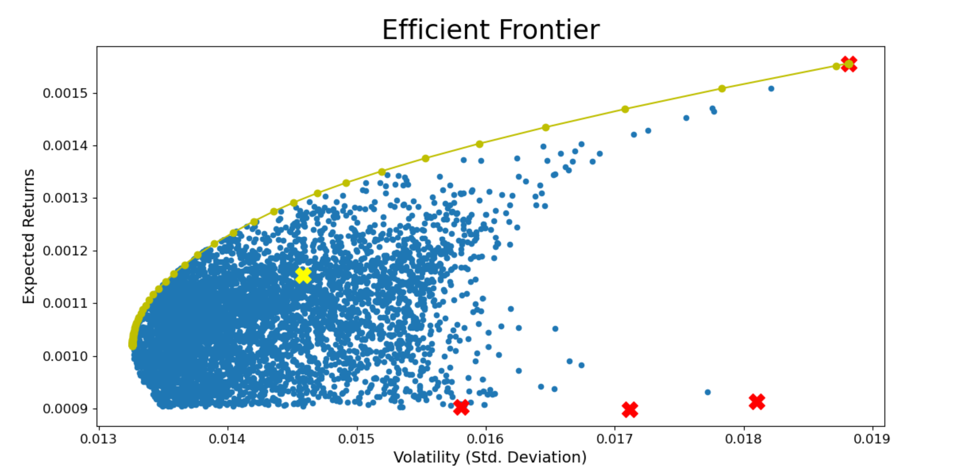
The Efficient Frontier
AMZN
Managed Portfolio
AMT
GOOG
AAPL

Slide 29
Intro: The Project
Data Import
Analyzing Stock Data
Creating Random Porfolios
Plotting Portfolios
Optimizing Portfolios
Adding More Stocks to the Portfolio
Conclusion

Slide 30
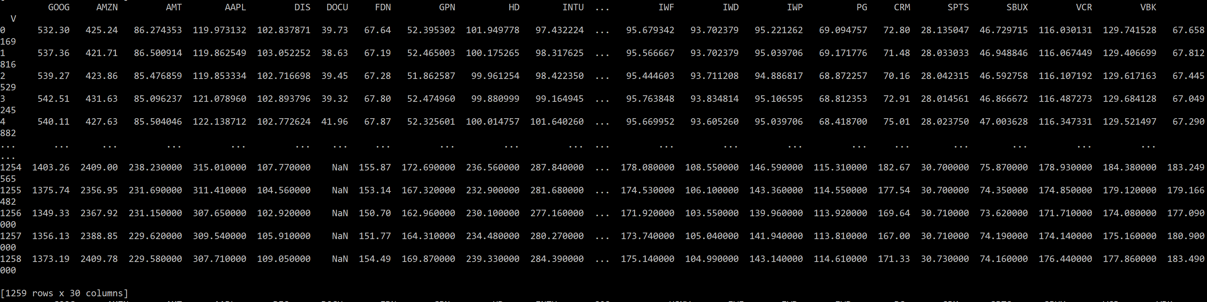
Adding More Stocks to the Portfolio
We can conduct the same analysis for a portfolio containing 30 stocks. Below is a sample of the stock data:

Slide 31
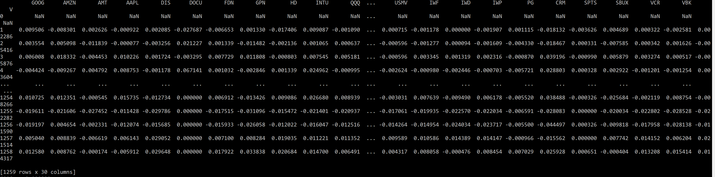
Adding More Stocks to the Portfolio
Below is the data frame containing percentage change data for the stocks:

Slide 32
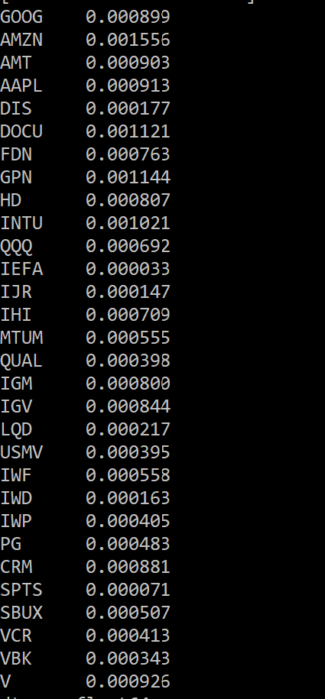
Adding More Stocks to the Portfolio
The expected returns for each stock are as follows:

Slide 33
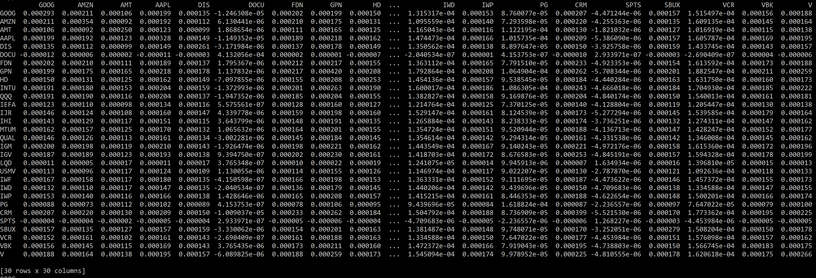
Adding More Stocks to the Portfolio
The Covariance Matrix

Slide 34
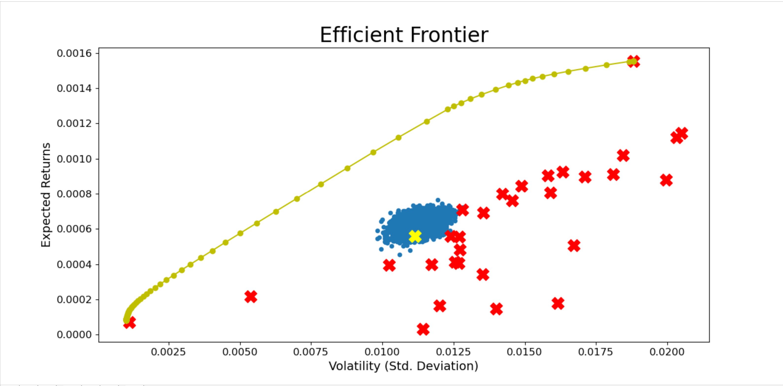
Adding More stocks to the Portfolio
The Efficient Frontier:

Slide 35
Intro: The Project
Data Import
Analyzing Stock Data
Creating Random Porfolios
Plotting Portfolios
Optimizing Portfolios
Adding More Stocks to the Portfolio
Conclusion

Slide 36
Conclusion
The analysis showed that the allocation of assets in the managed portfolio aren’t optimal to maximize expected returns and minimize risk.
However, the model is based on historical data, which never guarantee future success.
The analysis can be used for a number of assets to predict how financial resources should be optimally allocated.

Slide 37
Glossary I
Adjusted Closing Price: The closing price of a stock is only its cash value at day's end, whereas the adjusted closing price factors in things like dividends, stock splits and new stock offerings. Source: Link

Slide 38
Acknowledgements
Some code was taken from CodeCademy (Link)

